Slide 1
Preaching, Persuasion and Leadership: CASTING VISION Acknowledgments: Bill Hybels, “How to call for commitment” Bryan Wilkerson, “Visionary preaching”
Dr. Jeffrey Arthurs, Gordon-Conwell Theological Seminary, as taught at Singapore Bible College DMin module, March 2016
and offered for free download by Dr. Rick Griffith at BibleStudyDownloads.org

Slide 2
Twenty-first century leaders will lead not by the authority of their position but by their ability to articulate a vision and core values for their organizations or congregations.
Aubrey Malphurs
Warning: Vision leaks.

Slide 3
Preaching Modes
Informational Preaching
Exhortational Preaching
Prophetic Preaching
Therapeutic Preaching
Visionary Preaching

Slide 4
Visionary Preaching
Bryan Wilkerson:
“A form of expository preaching that empowers people to pursue God’s better future for their lives and churches by unleashing the transformative power of words, images, stories, and the person of the preacher.”

Slide 5
Preaching Modes
 | Informational | Exhortational | Prophetic | Therapeutic | Visionary
GOAL | Understanding | Action | Correction | Restoration | Transformation
VERB | Know something | Do something | Stop something | Feel something | Become something
KEY WORDS | Know Understand Believe Affirm | Must Need Should Ought | Don’t Beware Avoid Stop | Feel Sense Receive Enable | See Imagine Can What it would look like….
TAKE-AWAY | What’s True | What’s needed | What’s wrong | What’s helpful | What’s possible
TONE | Didactic | Urgent | Negative | Pastoral | Positive
DEPRAVITY FACTOR | Ignorance | Apathy | Disobedience | Woundedness | Faithlessness
PREACHER’S ROLE | Teacher | Coach | Prophet | Counselor | Leader

Slide 6
The vision-casting sermon:
Proclaiming “why we exist” is the foundational platform for any church’s administration. Understanding the purpose of the church is not something that should be taken for granted, but should be continually communicated as a regular staple of the preaching regimen.
James White, “Preaching and Administration,” Handbook of Contemporary Preaching, Michael Duduit, ed. (Nashville: Broadman and Holman, 1992): 455-456.

Slide 7
How to Cast vision from the Pulpit: four methods
Encourage/inspire.
“It will be worth it for you.”
Deut. 28:1-14; 30:11-16, 19-20.

Slide 8
Why Volunteers quit
No one ever said thanks.
There was no training.
I never knew exactly what they wanted me to do.
No one provided leadership, so my questions never got answered.
They forgot about me after they gave me the job.
I never received the tools and resources I needed.
It wasn’t any fun.
The Pastor’s Coach, www.injoy.com

Slide 9
How to Cast vision from the Pulpit: Four Methods
Encourage/inspire.
“It will be worth it for you.”
Deut. 28:1-14; 30:11-16, 19-20.
Warn.
“The wrong decision will result in pain for you.”
Deut. 28:15-68, 30:17-18; Prov. 7:6-27.
Model.
“I’ll go first.”
Josh. 24:14-15; 1 Chron. 29:1-5; John 13.

Slide 10
The life of the speaker has greater weight in determining whether he is obediently heard than any grandness of eloquence.
Augustine, On Christian Doctrine, trans. Robertson, 164.

Slide 11
Ask yourself: Am I living the kind of life I am recommending to others?

Slide 12
Share Your Self
“Every vision needs a vision-embodier.”
Bill Hybels
“You know how we lived among you for your sake. You became imitators of us and of the Lord . . . we were delighted to share with you not only the gospel of God but our lives as well.” I Thessalonians 2:6,8

Slide 13
How to cast vision from the Pulpit: Four methods
Encourage/inspire.
“It will be worth it for you.”
Deut. 28:1-14; 30:11-16, 19-20.
Warn.
“The wrong decision will result in pain for you.”
Deut. 28:15-68, 30:17-18; Prov. 7:6-27.
Model.
“I’ll go first.”
Josh. 24:14-15; 1 Chron. 29:1-5; John 13.
Grander vision.
“Give yourself to something bigger than yourself.”
Esther 4:12-14.

Slide 14
Why people support causes:
To do the right thing.
To feel good about something.
To contribute to society.
To join a social group.
To prove themselves.
To enrich their lives.
Guy Kawasaki, Selling the Dream (New York: Harper Collins, 1991), 53-54.

Slide 15
How To cast vision from the Pulpit: craft your language: “Use Better Words and Use Words Better” (Byran Wilkerson)
Concrete (not abstract)
Vivid (not dull)

Slide 16
I have found myself discovering that mostly I do not need more advice, but strength. I do not need new information, but the courage, freedom, and authorization to act on what I already have been given in the gospel . . . . The dry places in our lives—places of resistance and embrace—are not ultimately reached by instruction . . . but by stories, images, metaphors, and phrases that line out the world differently.
Walter Breuggeman

Slide 17
How To cast vision from the Pulpit: craft your language: “Use Better Words and Use Words Better” (Byran Wilkerson)
Concrete (not abstract)
Vivid (not dull)
Repeated (not spoken once then forgotten)

Slide 18
Repetition and vision
Preach a “state of the church” message every year.
Preach a series on the mission of the church every year.
Summarize your vision in one memorable statement and repeat it often.

Slide 19
Use Better Words and Use Words Better
Coin a phrase
Create a metaphor
Tell a story
“The human mind is a picture gallery, not a lecture hall, and the images that hang there shape our beliefs, behaviors and decisions.”
Warren Wiersbe

Slide 20
Story and Vision
Perhaps the most powerful tool for communicating the language of leadership within the preaching event is the use of stories that capture the essence of the vision.
James White, “Preaching and Administration,” Handbook of Contemporary Preaching, Michael Duduit, ed. (Nashville: B & H, 1992): 458-459.

Slide 21
How to cast vision from the pulpit: embody the vision
For there is no way in which the mind of the auditor may be aroused or soothed that I have not tried . . . . But, as I said before, it is no great intellectual gift [which enables me to arouse them], but a vigorous spirit which inflames me to such an extent that I am beside myself; and I am sure that the audience would never be set on fire unless the words that reached them were fiery.
Cicero, Orator (Loeb Classical Library), 130.

Slide 22
Casting vision and “sticky” ideas succes
Simple
Unexpected
Credible
Concrete
Emotional
Stories
(Heath and Heath, Made To Stick)

Slide 23
Case Study: Singleton “Turtles on Fencepost”
Rhetorical Situation: is this deliberative, forensic, or epideictic?
Does this sermon use “SUCCES”?
Simple
Unexpected
Concrete
Credible
Emotional
Story
Does the preacher coin a phrase?
Comment on the preacher’s delivery. Does he embody the message?

Slide 24
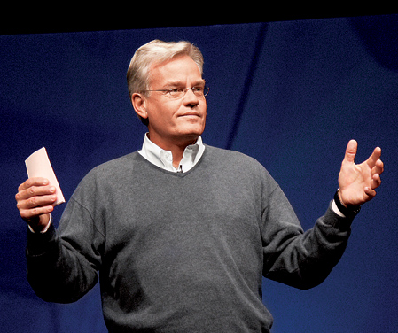
Case Study: Bill Hybels, “Firsts” track 6-10 (pp. 3-5 of transcript)
Does this sermon use “SUCCES”?
Simple
Unexpected
Concrete
Credible
Emotional
Story

Slide 25
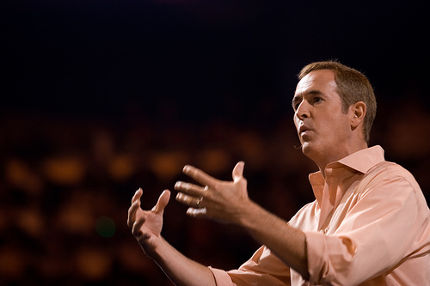
Case Study: Andy Stanley “Together” (start at 13:00, p. 4 of manuscript)
Does this sermon use “SUCCES”?
Simple
Unexpected
Concrete
Credible
Emotional
Story
Comment on Stanley’s :
Delivery. Does he embody the message?
Language.Is he direct? Does he use repetition? Is he concrete?
Transcendence. Does he ask them to give to something bigger than themselves?

Slide 26
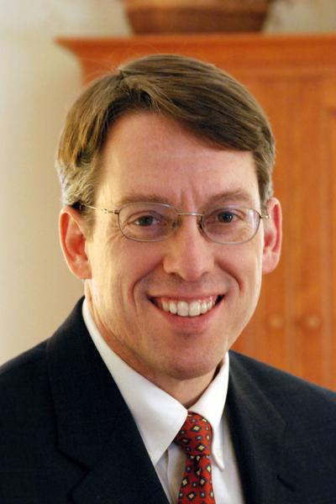
Case Study: Timothy Tennent, “The Translatability of the Gospel” (start at 20:00)
Does Tennent use concrete
language and repetition?
Does he create the mood by his delivery?
How is the sermon adapted to his
audience and occasion?

Slide 27
Black

Slide 28
Preaching (Homiletics) link at BibleStudyDownloads.org
Get this presentation for free!
Notes:
Preaching (pr)
Homiletics

